Slide 1

Interference Minimization for Device-to-Device (D2D) Communications: A Combinatorial Approach Peash Ranjan Saha*, Salimur Choudhury†, Daya Ram Gaur* IEEE Wireless Communication and Networking Conference (WCNC) 15-19 April 2019, Marrakech, Morocco. * Department of Mathematics & Computer Science, University of Lethbridge, Alberta, Canada. † Department of Computer Science, Lakehead University, Thunder Bay, Ontario, Canada.

Slide 2

Topics To Be Covered
Introduction
Contribution
System Model & Related Work
Problem Formulation
Two-Phase Approach
Implementation
Performance Evaluation
Conclusion and Future Work
Interference Minimization for Device-to-Device (D2D) Communications: A Combinatorial Approach

Slide 3
Introduction
Cellular network
A collection of cells (land area).
Each cell is controlled by a central base station.
Every user needs to go through the base station to transmit the signal.
Device-to-Device (D2D) communications underlaying cellular networks
D2D pairs communicate directly.
They skip the route through the base station to transmit signal.
Share the resources with cellular users.
Interference Minimization for Device-to-Device (D2D) Communications: A Combinatorial Approach

Slide 4
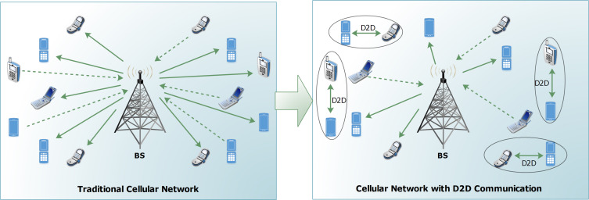
Introduction
Scenario
Advantages of D2D communications underlaying cellular networks
They increase the overall throughput of the networks.
Enables large number of inter-device applications.
4
Interference Minimization for Device-to-Device (D2D) Communications: A Combinatorial Approach

Slide 5
Introduction
Necessity of D2D communications underalying cellular networks
The number of smart handheld devices has exploded recently.
Rapid increment of inter-device applications in every aspect.
Example of inter-device applications
Communication between emergency vehicles.
Location-based advertisements.
Service application for a small area such as hospitals or conferences.
5
Interference Minimization for Device-to-Device (D2D) Communications: A Combinatorial Approach

Slide 6
Purpose & Motivation
Purpose
D2D communication generates a significant amount of interferences in the network while sharing the resources from the cellular users.
Create an assignment of the D2D pairs to the cellular users such that
The overall interference is minimum.
A target sum rate is satisfied.
Motivation
The current cellular networks are four generation old and use the traditional procedure for transmission.
D2D communication will play a major role to meet the challenges on the 5G network and beyond.
6
Interference Minimization for Device-to-Device (D2D) Communications: A Combinatorial Approach

Slide 7
Contribution
We study the interference minimization problem for device-to-device communication
underlaying cellular networks where all the interferences are uniform.
We propose a two-phase polynomial time algorithm.
The output of the algorithm is an assignment with the minimum interference while
satisfying a minimum target sum rate.
We determine the complexity to find an optimal solution for the uniform interference
case.
We tested our algorithm with both synthetic and random data.
We also analyze the performance of the algorithm in general.
Interference Minimization for Device-to-Device (D2D) Communications: A Combinatorial Approach
7

Slide 8
System Model & Related Work
System model
Signal-interference-noise-ratio (SINR) is the most commonly used interference model in wireless communication.
It determines the sum rates of the link and the interference generated by the other links.
Network model
The users can be divided into two sets.
Cellular users set (C).
D2D pairs set (D).
A cellular user can share spectrum resources with at most one D2D pair.
Interference Minimization for Device-to-Device (D2D) Communications: A Combinatorial Approach
8

Slide 9
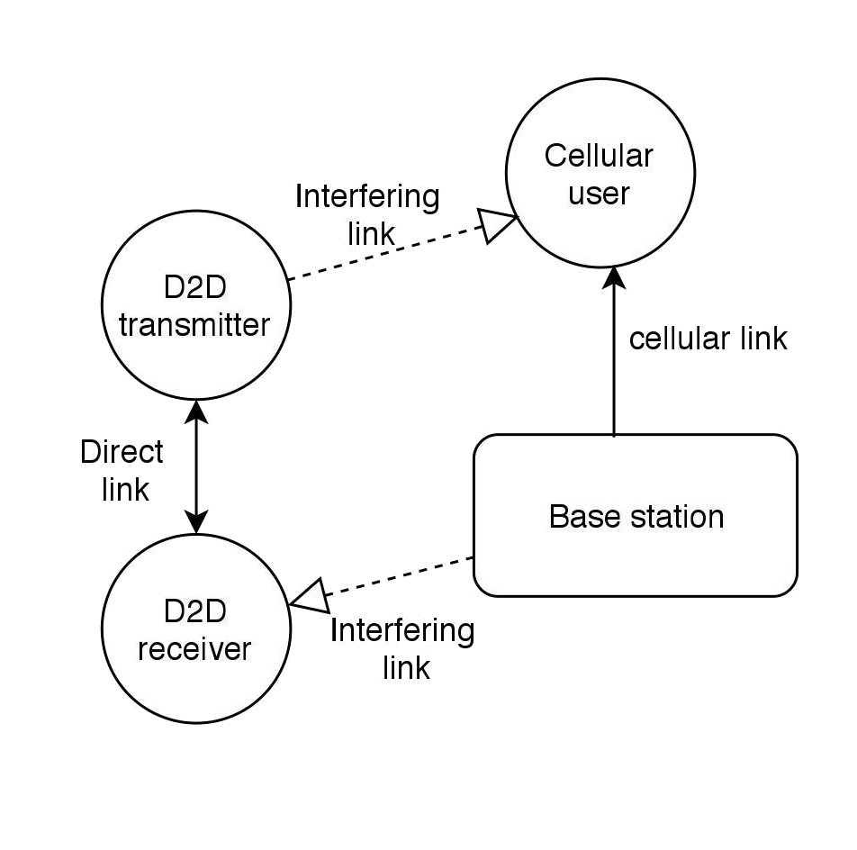
System Model & Related Work
Network model
Two types of intra-cell interference are generated.
From the D2D transmitters to the base station.
From the cellular users to the D2D receivers.
Scenario of the network model
9
Interference Minimization for Device-to-Device (D2D) Communications: A Combinatorial Approach

Slide 10
System Model & Related Work
Related work
Islam-et-al [3] proposed a local search based reassignment approach.
They restrict the interference at a target level in each assignment.
They swap the assignment if it improves the system sum rate.
Hussain-et-al [22] extended the method proposed in Islam-et-al.
They use three different sharing approach (One-to-One, One-to-many, many-to-many).
They discard the sharing that decreases system sum rate.
Hassan-et-al [5] also proposed a local search based two-stage approach.
They use the weighted bipartite matching algorithm in the first stage.
Local moves are used to decrease interference in the second stage.
Interference Minimization for Device-to-Device (D2D) Communications: A Combinatorial Approach
10

Slide 11
System Model & Related Work
Related work
Islam-et-al [6] proposed an auction-based two-stage resource allocation algorithm.
They begin with the solution with minimum interference.
They modify the assignment using an auction to improve the sum rate.
Feng-et-al [23] proposed an approach based on the admissibility of the D2D pairs.
Hussain-et-al [17] proposed another strategy using maximum weighted bipartite matching algorithm.
They impose the constraint on the sharing which are not useful.
They ensure each sharing maintains a minimum target sum rate.
Interference Minimization for Device-to-Device (D2D) Communications: A Combinatorial Approach
11

Slide 12
Problem Formulation
Notation
A bipartite graph can be formulated with the set C = cellular user set, and the set D = d2d pair set.
An edge (c,d) exists if shares the resources from .
s_{(c,d)} is the sum rate of the edge (c,d) and i_{(c,d)} is the interference generated by the edge.
Both s_{(c,d)} and i_{(c,d)} can be calculated using the SINR model.
Let define a decision variable x_{(c,d),} which is 1 when (c,d) exists, otherwise 0.
S is the total sum rate and P is the target sum rate.
Interference Minimization for Device-to-Device (D2D) Communications: A Combinatorial Approach
12

Slide 13
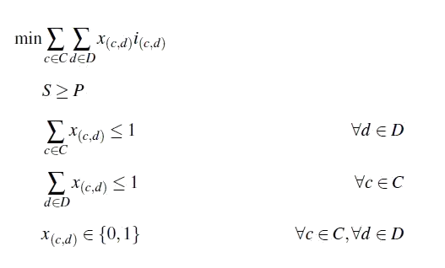
Problem Formulation
Integer linear program
An integer linear program (ILP) for the interference minimization problem is given below.
The objective function is to minimize the total interference.
The first constraint is for the minimum target sum rate and second and third constraints impose the matching.
Interference Minimization for Device-to-Device (D2D) Communications: A Combinatorial Approach
13

Slide 14
Two-Phase Approach
Characterization
We characterize the optimal solution for uniform interference. (Objective is to minimize the
total number of edges).
Let assume M is the current matching. We define a particular structure with respect to M.
Decrementing Structure
It is an alternating path starts and ends by matched edge and alternate between
matched and unmatched edges.
The number of matched edges is one more than the number of unmatched edges.
The total weight of the unmatched edges is at least the total weight of the matched
edges.
Interference Minimization for Device-to-Device (D2D) Communications: A Combinatorial Approach
14

Slide 15
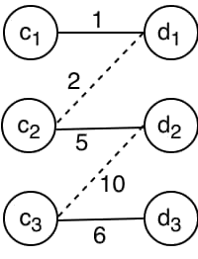
Two-Phase Approach
Characterization
Example of a decrementing path.
Here solid lines represent the matched edges and dashed lines represents the unmatched edges and weight of the edges are given with the edges.
We proved the following lemma.
If M is not optimal, then there exists a decrementing path with respect to M.
15
Interference Minimization for Device-to-Device (D2D) Communications: A Combinatorial Approach

Slide 16
Two-Phase Approach
Characterization
Let assume Z = e₁, e₂, e₃, e₄, e₅,………. is a decrementing path where e₁, e₂, e₃ is the
starting triple of edges and has the following property.
e₁, e₃ in M and e₂ is not in M.
e₂ has one common endpoint with both e₁ and e₃.
If is the matching induced by the subgraph with the vertex set ,
then is also a matching where has one less edge than and
Updating the current matching with improves the solution.
Starting triple of the decrementing path needs to determine efficiently as every
triple with respect to is a candidate for e₁, e₂, e₃.
16
Interference Minimization for Device-to-Device (D2D) Communications: A Combinatorial Approach

Slide 17
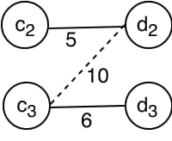
Two-Phase Approach
Characterization
Special triple
Triple of three edges e₁, e₂, e₃ with respect to M such that e₁, e₃ is in M and e₂ is not in M and . .
Example of a special triple
Here e₁ = (c₁,d₁), e₂ = (c₂,d₁) and e₃ = (c₂,d₂).
We proved the following lemma.
If there exists a decrementing path Z with respect to M, then there exists a special triple with respect to M.
17
Interference Minimization for Device-to-Device (D2D) Communications: A Combinatorial Approach

Slide 18
Two-Phase Approach
Characterization
Instead of trying with every triple as a candidate of the starting triple of the
decrementing paths, we search for the special triple to determine the decrementing paths.
Updating the current matching M iteratively using the decrementing paths until there
exists any generates the optimal solution.
We ensure the target sum rate is satisfied in the first phase.
In the second phase, we determine the decrementing paths using the special triples to
generate a matching with the minimum number of edges while maintaining the same sum
rate as in the first phase.
18
Interference Minimization for Device-to-Device (D2D) Communications: A Combinatorial Approach

Slide 19
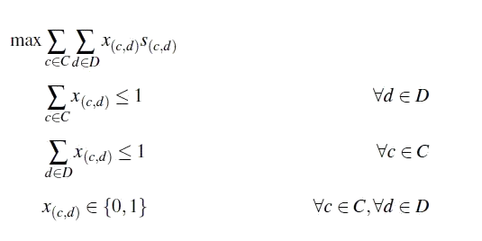
Two-Phase Approach
First Phase
We solve the maximum weighted bipartite matching problem considering only the sum
rate as the weight of the edges.
The integer linear program for the first phase is given below.
x_{(c,d)} is the decision variable for the edges between a cellular user c and a d2d pair d and s_{(c,d)} is the sum rate of that edge.
19
Interference Minimization for Device-to-Device (D2D) Communications: A Combinatorial Approach

Slide 20
Two-Phase Approach
First Phase
The output of the first phase is a matching M.
If the total sum rate of all of the edges in M does not satisfy the target sum
rate, then no solution is possible.
Otherwise, we calculate the slack value α using the following formula.
The purpose of calculating the α is to determine how much sum rate can be relaxed in the
second phase if M is not optimal in terms of the number of edges.
We assume α = 0 and the target of the second phase is to minimize the number of edges in
the matching while maintaining the same sum rate.
20
Interference Minimization for Device-to-Device (D2D) Communications: A Combinatorial Approach

Slide 21
Two-Phase Approach
Second Phase
We propose a combinatorial algorithm in the second phase.
The algorithm searches for the special triples to determine the decrementing paths until
there exists any.
The algorithm searches for the special triples in one set as special triples are identical
from both sets.
The existence of a special triple does not guarantee the existence of a decrementing path.
The algorithm generates a temporary maximum weighted matching induced by the
subgraph and updates with if .
21
Interference Minimization for Device-to-Device (D2D) Communications: A Combinatorial Approach

Slide 22
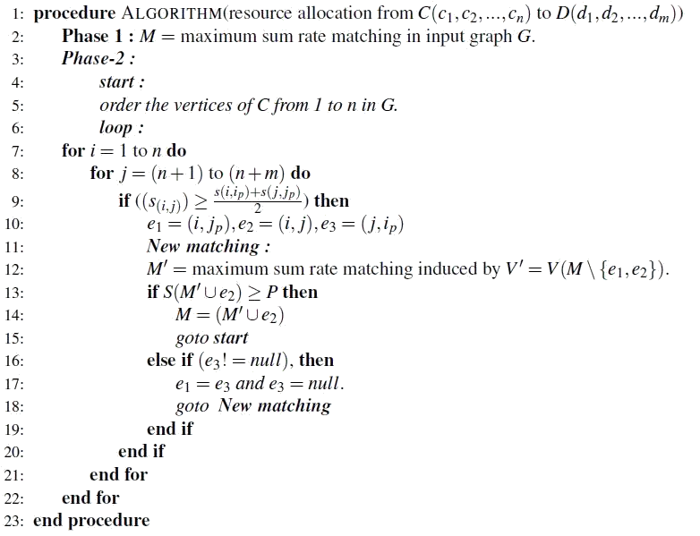
Two-Phase Approach
Second Phase Algorithm
22
Interference Minimization for Device-to-Device (D2D) Communications: A Combinatorial Approach

Slide 23
Two-Phase Approach
Proof of Correctness
The output of the first phase is the matching which satisfies the minimum target sum rate.
We proved the following lemma for the second phase.
If there exists a decrementing path Z with respect to M, then the algorithm always updates M.
Every update of the algorithm decreases the matching size by at least 1.
The algorithm searches for the special triples to determine the decrementing paths
until there exists any.
The final output of the algorithm is the matching with the minimum number of edges
while satisfying the minimum target sum rate.
23
Interference Minimization for Device-to-Device (D2D) Communications: A Combinatorial Approach

Slide 24
Two-Phase Approach
Complexity
We define an update using the decrementing path as a step of the algorithm.
Searching for the special triple takes O(|V|_{c2}) steps since there are |V|_{c2} possible choice for e₁ and e₃ and two choices for e₂ for each case.
We consider the algorithm is solving the subproblem for all possible triples as we do not know the frequency of the special triples.
Solving of the subproblem takes O(|V|³) steps. So, the complexity of determining a decrementing path using the special triples is O(|V|⁵).
Each step reduces the number of the edge by at least 1. So, the maximum number of updates is O(|V|), which makes the total complexity of the algorithm is O(|V|⁶).
24
Interference Minimization for Device-to-Device (D2D) Communications: A Combinatorial Approach

Slide 25
Implementation
We implement the simulation process in IBM ILOG CPLEX 12.8.
We define the integer linear programs using the Optimization Programming Language (OPL).
We define a primary model to generates the graph instance and initialize the parameters.
We assume the graph is complete and n vertices in each side.
We compute an incident matrix to store the graph information.
We define a separate model to define the integer linear program for the first phase.
The primary model uses the secondary model to execute the first phase and the
subproblem of the second phase. It then uses the incident matrix to generate and return
the final matching.
25
Interference Minimization for Device-to-Device (D2D) Communications: A Combinatorial Approach

Slide 26
Performance Evaluation
We perform multiple simulations for the graphs with vertices in the range of 4 to 500.
We consider even number of vertices and split into two equal sized sets.
We perform different experiments for the real network data and for the random data.
We follow the SINR model and use the parameters as Islam-et-al [6] to generate the sum
rate of the edges while considering uniform interferences.
We compare our algorithm with the integer linear program (ILP) solution of the
interference minimization problem.
Our algorithm successfully improves the solution in the second phase, whenever the first
phase solution is not optimal.
It always returns the same interference as the ILP solution.
26
Interference Minimization for Device-to-Device (D2D) Communications: A Combinatorial Approach

Slide 27
Performance Evaluation
Performance on the real network data
We show some notable instances in the following table.
* All times are given in second.
|V| | |E| | I in ILP | Time : ILP | I after phase 1 | I after phase 2 | Time: phase 1 | Time: phase 2 with no update | Time: phase 2 with update | Time : Algorithm
10 | 25 | 4 | 0.0106 | 5 | 4 | 0.0062 | 0.0150 | 0.0013 | 0.0303
28 | 196 | 12 | 0.0446 | 14 | 12 | 0.0123 | 0.0570 | 0.0570 | 0.1599
64 | 1024 | 28 | 0.5358 | 32 | 28 | 0.0667 | 2.8637 | 2.8637 | 6.2092
90 | 2025 | 42 | 2.1359 | 45 | 42 | 0.1746 | 9.0720 | 0.4826 | 17.8165
150 | 5625 | 71 | 15.094 | 75 | 71 | 0.7025 | 104.2081 | 3.7 | 204.8778
174 | 7569 | 84 | 24.219 | 87 | 84 | 0.9544 | 135.633 | 4.0689 | 226.055
220 | 12100 | 104 | 31.121 | 110 | 104 | 1.4437 | 137.8935 | 4.1672 | 277.428
310 | 24025 | 149 | 71.414 | 155 | 149 | 2.8666 | 273.7927 | 8.2742 | 429.096
27
Interference Minimization for Device-to-Device (D2D) Communications: A Combinatorial Approach

Slide 28
Performance Evaluation
Performance on random data
We also verified our algorithm on random data for the sum rate.
We assign a uniformly generated random value within the range (1-50) as a sum rate for each edge.
We use a threshold value δ, within the range (0-1) to initialize zero-sum rate for some edges.
Another random value β, within the range (0-1) is generated for each edge and if β < δ, then zero-sum
rate is assigned to that edge.
The number of zero-sum increases as δ is getting high and chances of finding the decrementing
structure in phase 2 is also increases.
Our algorithm always return the interference as ILP does for the random data with different δ values.
28
Interference Minimization for Device-to-Device (D2D) Communications: A Combinatorial Approach

Slide 29
Performance Evaluation
Performance on random data
We show some notable instances in the following table for δ = 0.4.
* All times are given in second.
|V| | |E| | I in ILP | Time : ILP | I after phase 1 | I after phase 2 | Time: phase 1 | Time: phase 2 with no update | Time: phase 2 with update | Time : Algorithm
16 | 64 | 7 | 0.0166 | 8 | 7 | 0.0096 | 0.0209 | 0.0042 | 0.0427
40 | 100 | 18 | 0.1019 | 20 | 18 | 0.0224 | 0.2871 | 0.0209 | 0.5684
74 | 1369 | 35 | 0.9082 | 37 | 35 | 0.0969 | 4.3370 | 0.1162 | 8.4565
120 | 3600 | 57 | 6.2196 | 60 | 57 | 0.3679 | 26.7939 | 1.0241 | 59.0941
168 | 7056 | 80 | 10.302 | 84 | 80 | 0.6262 | 69.4826 | 1.7574 | 115.4051
218 | 11881 | 106 | 13.032 | 109 | 106 | 1.0062 | 91.1816 | 4.4604 | 148.868
266 | 17689 | 129 | 16.618 | 133 | 129 | 1.4109 | 134.7855 | 5.9573 | 212.7633
320 | 25600 | 153 | 62.423 | 158 | 153 | 3.0064 | 241.4716 | 10.6051 | 326.313
340 | 28900 | 164 | 56.929 | 170 | 164 | 2.9534 | 303.9525 | 8.2212 | 374.0301
390 | 38416 | 186 | 105.559 | 192 | 186 | 5.6918 | 425.465 | 20.422 | 567.2867
29
Interference Minimization for Device-to-Device (D2D) Communications: A Combinatorial Approach

Slide 30
Performance Evaluation
Discussion
Our algorithm always determines the decrementing structures successfully and return interference as the ILP
solution of the interference minimization problem.
The total time needed for our algorithm is more significant.
The reason is for solving the subproblem model while searching for the decrementing paths when there is no
update possible, which takes the maximum amount of time in phase 2.
We show the percentage of time needed in the different stage of phase 2 in the following pie chart.
30
Interference Minimization for Device-to-Device (D2D) Communications: A Combinatorial Approach

Slide 31
Performance Evaluation
Discussion
Our algorithm would be faster by a factor of 10, if the special triples could be identified with
certainty to determine the decrementing structures.
The algorithm works better for the general interference scenario.
31
Interference Minimization for Device-to-Device (D2D) Communications: A Combinatorial Approach

Slide 32
Conclusion & Future Work
D2D communications underlaying cellular networks is a significant addition for the future
generation networks.
It enables a wide variety of location-based services.
We study the problem of creating an assignment of the D2D pairs to the cellular users to share
resources, such that total interference is minimum while maintaining a target sum rate.
We propose a two-phase combinatorial algorithm for the problem.
Our algorithm generates an optimal solution in polynomial time for the uniform interference.
We evaluate our algorithm with both synthetic and random data.
32
Interference Minimization for Device-to-Device (D2D) Communications: A Combinatorial Approach

Slide 33
Conclusion & Future Work
Time needed for our algorithm is much more than the time needed to solve the ILP for the
interference minimization problem.
A faster algorithm to determine the necessary special triples can be a significant extension of
the thesis.
Further study can be done for the general interference scenario.
An approximation algorithm can be developed based on our algorithm for the non-uniform
interference case.
33
Interference Minimization for Device-to-Device (D2D) Communications: A Combinatorial Approach

Slide 34
References
[1] Marko H o¨yhtya¨, Olli Apilo, and Mika Lasanen. Review of Latest Advances in 3GPP Standardization: D2D Communication in 5G Systems and Its Energy Consumption Models. Future Internet, 10(1)(3), 2018.
[2] Md Yeakub Hassan, Faisal Hussain, Md Sakhawat Hossen, Salimur Choudhury, and Muhammad Mahbub Alam. A near optimal interference minimization resource allocation algorithm for D2D communication. In IEEE International Conference on Communi- cations, ICC, Paris, France, May 21-25, 2017, pages 1–6.
[3] Y. Hassan, F. Hussain, S. Hossen, S. Choudhury, and M. M. Alam. Interference Minimization in D2D Communication Underlaying Cellular Networks. IEEE Access, 5:22471–22484, October 2017.
[4] M. T. Islam, A. M. Taha, S. Akl, and S. Choudhury. A two-phase auction-based fair resource allocation for underlaying D2D commu- nications. In IEEE International Conference on Communications (ICC), pages 1–6, May 2016.
[5] C. Xu, L. Song, Z. Han, Q. Zhao, X. Wang, X. Cheng, and B. Jiao. Efficiency Resource Allocation for Device-to-Device Un- derlay Communication Systems: A Reverse Iterative Combinatorial Auction Based Approach. IEEE Journal on Selected Areas in Communications, 31(9):348–358, September 2013.
[6] C. Xu, L. Song, Z. Han, Q. Zhao, X. Wang, and B. Jiao. Interference-aware resource allocation for device-to-device commu- nications as an underlay using sequential second price auction. In IEEE International Conference on Communications (ICC), Ottawa, Canada, pages 445–449, June 2012.
[7] Tae-Sub Kim, Kwang-Hyung Lee, Seungwan Ryu, and Choong- Ho Cho. Resource Allocation and Power Control Scheme for Interference Avoidance in an LTE-Advanced Cellular Networks with Device-to-Device Communication. SERSC : International journal of control and automation, 6(1):181–190, February 2013.
[8] Rongqing Zhang, Xiang Cheng, Liuqing Yang, and Bingli Jiao. Interference-aware graph based resource sharing for device-to- device communications underlaying cellular networks. In IEEE Wireless Communications and Networking Conference (WCNC), Shanghai, China, pages 140–145, April 2013.
34
Interference Minimization for Device-to-Device (D2D) Communications: A Combinatorial Approach

Slide 35
References
[9] M. T. Islam, A. M. Taha, S. Akl, and S. Choudhury. A Local Search Algorithm for Resource Allocation for Underlaying Device- to-Device Communications. In IEEE Global Communications Conference (GLOBECOM), San Diego, CA, USA, pages 1–6, Dec 2015.
[10] F. Hussain, M. Y. Hassan, M. S. Hossen, and S. Choudhury. System Capacity Maximization With Efficient Resource Allocation Algorithms in D2D Communication. IEEE Access, 6:32409–32424, May 2018.
[11] D. Feng, L. Lu, Y. Yuan-Wu, G. Y. Li, G. Feng, and S. Li. Device- to-Device Communications Underlaying Cellular Networks. IEEE Transactions on Communications, 61(8):3541–3551, August 2013.
[12] F. Hussain, M. Y. Hassan, M. S. Hossen, and S. Choudhury. An optimal resource allocation algorithm for D2D communication underlaying cellular networks. In 14th IEEE Annual Consumer Communications Networking Conference (CCNC), Las Vegas, USA, pages 867–872, Jan 2017.
[13] P. Janis, V. Koivunen, C. Ribeiro, J. Korhonen, K. Doppler, and K. Hugl. Interference-Aware Resource Allocation for Device-to- Device Radio Underlaying Cellular Networks. In VTC Spring 2009- IEEE 69th Vehicular Technology Conference, pages 1–5, April 2009.
[14] K. Doppler, M. Rinne, C. Wijting, C. B. Ribeiro, and K. Hugl. Device-to-device communication as an underlay to LTE-advanced networks. IEEE Communications Magazine, 47(12):42–49, Decem- ber 2009.
[15] Xu C. Song L., Han Z. Radio resource management. In: Resource Management for Device-to-Device Underlay Communi- cation, Springer, New York, NY, 2013.
[16] Pekka Janis, Chia-Hao Yu, Klaus Doppler, C a´ssio Ribeiro, Carl Wi- jtingand Klaus Hugh, Olav Tirkkonen, and Visa Koivuen. Device- to-Device Communication under Laying Cellular Communications Systems. International journal of communications, Network and System Sciencese, 2(3):169–178, June 2009.
[17] C. Yu, O. Tirkkonen, K. Doppler, and C. Ribeiro. On the Performance of Device-to-Device Underlay Communication with Simple Power Control. In VTC Spring 2009 - IEEE 69th Vehicular Technology Conference, pages 1–5, April 2009.
35
Interference Minimization for Device-to-Device (D2D) Communications: A Combinatorial Approach

Slide 36
References
[18] Holger Boche and Martin Schubert. A unifying approach to interference modeling for wireless networks. IEEE Transactions on Signal Processing, 58(6):3282–3297, June 2010.
[19] Yue Li and Lin Cai. Cooperative Device-to-Device Communication for Uplink Transmission in Cellular System. IEEE Transactions on Wireless Communications, 2018.
[20] Aravind Iyer, Catherine Rosenberg, and Aditya Karnik. What is the right model for wireless channel interference? IEEE Transactions on Wireless Communications, 8(5), 2009.
[21] M. Zulhasnine, C. Huang, and A. Srinivasan. Efficient resource allocation for device-to-device communication underlaying LTE network. In IEEE 6th International Conference on Wireless and Mobile Computing, Networking and Communications, Niagara Falls, Canada, pages 368–375, October 2010.
[22] M. Tauhidul Islam, A. M. Taha, and S. Akl. Reducing the complexity of Resource Allocation for underlaying Device-to- Device communications. In International Wireless Communications and Mobile Computing Conference (IWCMC), Dubrovnik, Croatia, pages 61–66, August 2015.
[23] Zvi Galil. Efficient algorithms for finding maximum matching in graphs. ACM Computing Surveys (CSUR), 18(1):23–38, 1986.
[24] IBM analytics. CPLEX Optimizer. https://www.ibm.com/analytics/ cplex-optimizer.
[25] George Bernard Dantzig, Lester Randolph Ford Jr, and Delbert Ray Fulkerson. A primal-dual algorithm. Technical report, RAND CORP SANTA MONICA CA, 1956.
36
Interference Minimization for Device-to-Device (D2D) Communications: A Combinatorial Approach

Slide 37
THANKS!
Any questions?
You can find me at: salimur.choudhury@lakeheadu.ca

